Slide 1
⚡ ELECTRA CARS
Test Drive Agent
From a 1% Web Form to a 60-Second WhatsApp Conversation
Salesforce Agentforce · Automotive Cloud · Digital Engagement (WhatsApp)
Salesforce Agentforce Hackathon · 5-Minute Pitch
Presented by team smartAgentCrew · May 2026

Slide 2
01
The Problem We Are Solving
Electra Cars website — high traffic, low conversion
1%
10+
48h
63%
Test-drive form
conversion rate
Form fields before
any submit
Avg. callback delay
from dealer
Drop-off mid-form
(industry avg.)
Pain Points
🚧 High Friction
🐢 Manual Bottlenecks
10+ field form before submission — most customers abandon
Call-center chases customers for missing model/location/time
📉 Low Conversion
📭 No Self-Service
Only ~1 in 100 visitors actually books a test drive
Cancel / reschedule requires another phone call to dealer

Slide 3
02
Our Solution — Electra AI Agent
Replace the form with a 60-second AI-led conversation
Electra AI
WhatsApp — Live Conversation
Conversational Test-Drive Concierge
Hi, I'd like to test drive an Electra
Welcome! Let me find your perfect Electra…
🤖 Powered by Einstein LLM — natural multi-turn chat💬 Native WhatsApp + Website Embedded Chat📍 Auto-routing to nearest dealer by ZIP🔐 OTP verification for every booking change🎯 AI Vehicle Matchmaker — 3-question quiz📲 Real-time WhatsApp confirmations🔁 End-to-end self-service: book / cancel / reschedule
X1 (320 mi range, 5 seats)
Coupe (sport, 4 seats)
SUV (400 mi, 7 seats)
The X1 please, Saturday 10 AM, 94105
Sending OTP to verify your number…
847291
✅ Booking TD-00423 confirmed at
Bay Area Electra Motors. WhatsApp sent.

Slide 4
03
Solution Architecture
Built end-to-end on Salesforce — minimal external dependencies
CUSTOMER CHANNELS
💬 WhatsApp (Twilio + Meta) 🌐 Website Embedded Chat 📱 Future: SMS / Apple Business Chat
AGENTFORCE — Electra Test Drive Assistant (Einstein LLM)
Topic 1
Book Test Drive
Topic 2
Cancel Booking
Topic 3
Reschedule
Topic 4
Matchmaker Quiz
AGENT ACTIONS — 10 Autolaunched Flows + 1 Apex Class
A1 GetVehicleModels
A2 FindDealerByZip
A3 CreateBooking
A4 SendWhatsApp
A5 GenerateOTP
A6 ValidateOTP
A7 LookupTestDrive
A8 CancelTestDrive
A9 RescheduleDrive
A10 RecommendVehicle
AUTOMOTIVE CLOUD DATA LAYER
VehicleDefinition · Lead (+OTP fields) · TestDrive__c · Account (Dealer RT) · Task (dealer notification)

Slide 5
04
What We Built — Concrete Deliverables
Every component deployed, tested, and active in the org
🤖
💡
⚙️
🔐
1
4
7
2
Agentforce Agent
Topics Configured
Agent Action Flows
Apex Class
Electra Test Drive Assistant
Book / Cancel / Reschedule / Matchmaker
All Autolaunched & Active in org
OTPGenerator (Crypto.getRandomInteger)
📋
🗂️
📨
🛡️
21
1
4
1
Custom Fields
Custom Object
WhatsApp Templates
Permission Set
Lead, Account, TestDrive, VehicleDefinition
TestDrive__c (booking record)
OTP / Confirm / Cancel / Reschedule
Electra_Agent_Fields (FLS for runtime user)
Day-by-Day Build Story
Day 1
Data model — 21 custom fields, TestDrive__c object, VehicleDefinition seed data, Dealer record type
Day 2
OTPGenerator Apex (cryptographically secure) + 4 WhatsApp templates submitted to Meta
Day 3
10 Autolaunched Flows built and activated — GetVehicleModels through RecommendVehicle
Day 4
Agentforce Agent + 4 Topics — Einstein LLM wired to all 10 actions; OTP gating enforced
Day 5
End-to-end test: Book → OTP → Confirm → Cancel → Reschedule — all under 60 seconds

Slide 6
05
Smart Use of Salesforce Platform
We bought zero new tools — every capability already on the platform
🏎️ Automotive Cloud (used as-is)
🤖 Agentforce + Einstein LLM
VehicleDefinition — vehicle catalog (no rebuild)
Lead — extended with 6 OTP + WhatsApp fields
Account / Dealer record type — ZIP routing source
Out-of-the-box objects → 0 rebuild cost
1 Agent with 4 Topics (Book/Cancel/Reschedule/Match)
10 Flow-backed actions, 1 Apex action
Native LLM reasoning — no prompt engineering needed
Topic scope expressions auto-route conversations
⚙️ Flows + Apex (low-code first)
💬 Digital Engagement (WhatsApp)
10/10 actions delivered as Autolaunched Flows
Only 1 Apex class (OTPGenerator) — security-critical
Zero LWC, zero triggers — easy hand-off to admins
Subflows for shared logic (SendWhatsAppMessage)
Native WhatsApp Channel via Twilio + Meta
4 pre-approved Meta templates (Auth + Utility)
Messaging Sessions = automatic audit trail
Embedded Service Chat reused on website

Slide 7
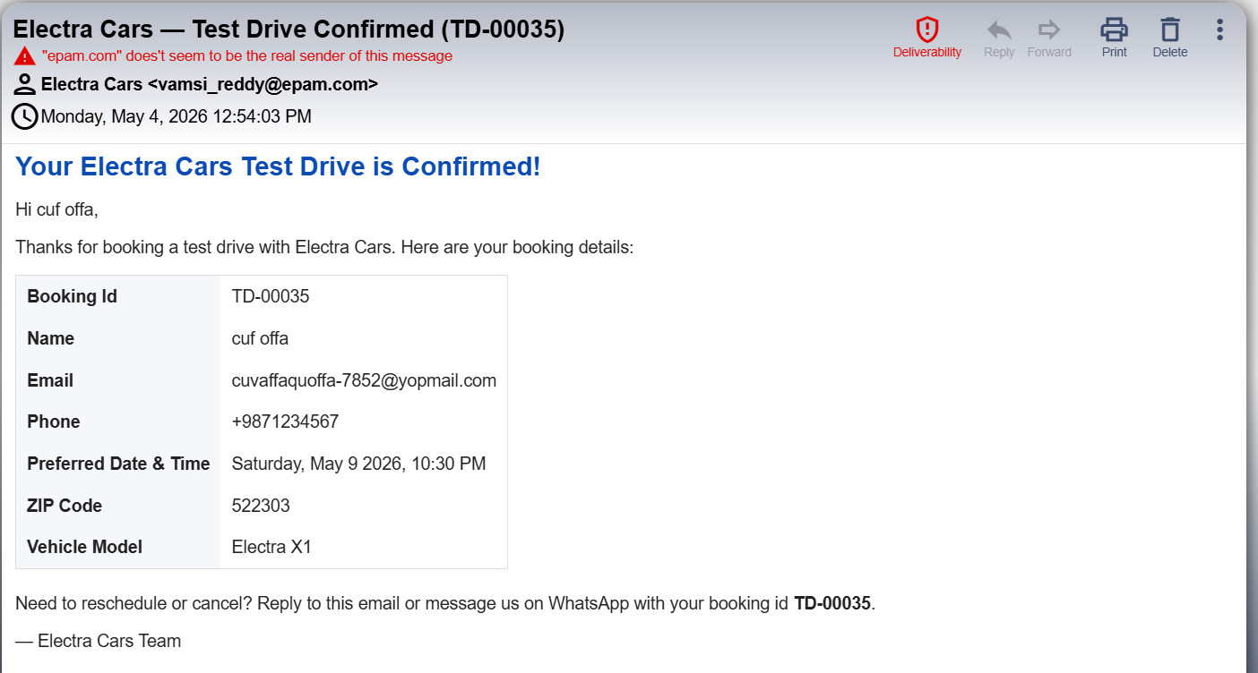
05
Smart Use of Salesforce Platform
We bought zero new tools — every capability already on the platform

Slide 8
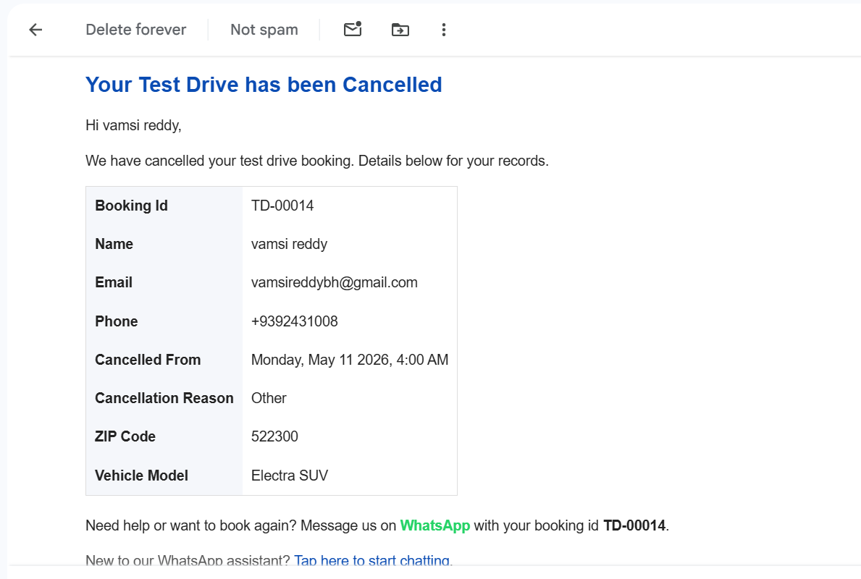
05
Smart Use of Salesforce Platform
We bought zero new tools — every capability already on the platform

Slide 9
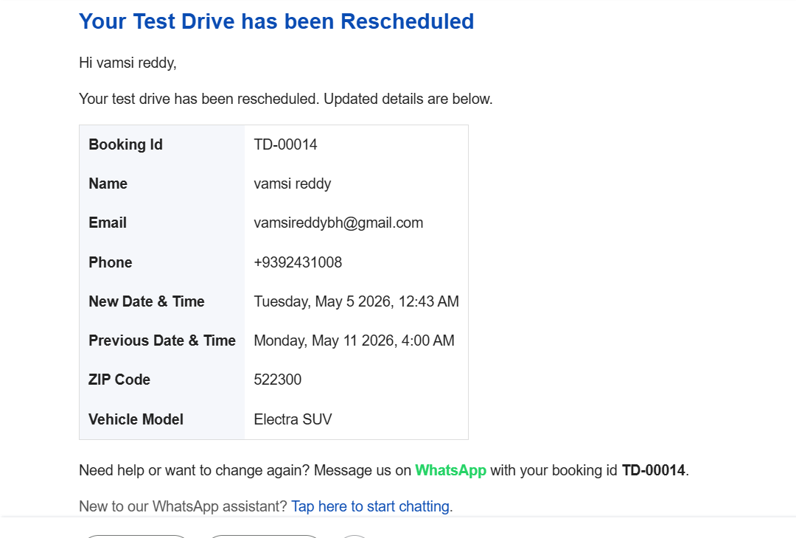
05
Smart Use of Salesforce Platform
We bought zero new tools — every capability already on the platform

Slide 10
06
Live Demo Snapshot
What you will see in the next 60 seconds of the demo
👋 Greet
▶
🚗 Choose Model
▶
📅 Pick Date
▶
📍 ZIP
▶
🔐 OTP
▶
✅ Booked
▶
📨 WhatsApp
🎯 Lead Created
🚙 TestDrive Booked
📞 Dealer Notified
✓ Alex Chen
✓ TD-00423
✓ Task auto-created
✓ +1 415-555-0192
✓ Electra X1 2025
✓ Subject: New Test Drive Booked
✓ ZIP 94105
✓ Apr 26, 10:00 AM
✓ Priority: High
✓ WhatsApp_Opt_In = TRUE
✓ Status: Scheduled
✓ WhatId: Dealer Account
✓ OTP_Verified = TRUE
✓ Bay Area Electra Motors
✓ ActivityDate: booking date

Slide 11
07
Advantages · Impact · Differentiation
Why this beats the legacy form — and every other hackathon entry
✅ Customer & Business Advantages
📈 Projected Impact
60-second booking
10×
−80%
−60%
vs. 5-minute web form → expect 10× conversion lift
True self-service
Conversion lift (1% → 10%)
Time-to-book (5 min → 60 sec)
Call-center workload
Cancel & reschedule with no human handoff
Phone verified at source
OTP eliminates fake leads → cleaner CRM
Smart dealer routing
ZIP lookup auto-assigns the right showroom
⭐ What Makes Us Different
Personalised quiz
▸ AI Vehicle Matchmaker — turns indecision into ownership
Matchmaker recommends the right vehicle (FOMO + ownership psychology)
▸ OTP across all 3 journeys — security-grade self-service
Dealer awareness
▸ ZIP-based auto-routing — zero dealer-assignment overhead
Auto-Task created → no missed bookings
▸ Topic scope guards — prevents AI from going off-track
100% audited
Messaging Sessions log every WhatsApp message
▸ 100% Salesforce-native — no external orchestration tools

Slide 12
08
Iterations We Made During the Hackathon
Real production-grade engineering — not just a happy path
Each issue below was discovered, root-caused, and fixed during build:
⚠ UNKNOWN_EXCEPTION calling GetVehicleModels
✓ Fix Applied
→
Field-Level Security blocked agent runtime user
Created Electra_Agent_Fields permission set, assigned to all EinsteinServiceAgent users
⚠ Flow returned null vehicle list
✓ Fix Applied
→
VehicleDefinition records had blank custom fields
Bulk updated 3 records with full Use_Case, Seating, Feature, Description data
⚠ Agent kept caching old flow version
✓ Fix Applied
→
Agentforce caches at activation, not runtime
Added 'Deactivate → Reactivate after every Flow redeploy' to runbook
⚠ Picklist field crashed Flow formula
✓ Fix Applied
→
Picklists not allowed in raw formula expressions
Wrapped Use_Case__c & Primary_Feature__c in TEXT() formula elements
⚠ SObject collection unreadable by LLM
✓ Fix Applied
→
Managed-package SObject lists serialise poorly
Refactored to output a formatted Text summary (vehicleSummary)
⚠ 'Answer with Knowledge' hijacked queries
✓ Fix Applied
→
Default Service Agent action shadowed flow
Removed Knowledge action from all 4 topics; tightened topic scope

Slide 13
09
Future Improvements — With More Time
Realistic 90-day roadmap that doubles down on conversion + scale
0-30 Days · Quick Wins
30-60 Days · Intelligence
60-90 Days · Scale
WhatsApp Native Catalog — embed vehicle cards with 1-tap booking
Live Social Proof injection — '47 X1 bookings this month near you'
Abandoned Conversation Recovery — auto-WhatsApp nudge in 30 min
Customer Location Share — replace ZIP typing with WhatsApp GPS pin
Digital Booking Pass — branded Experience Cloud page + QR code
Data Cloud + Personalization API — return-visitor recognition
Dynamic Incentive Engine — Einstein Next Best Action for offers
Multilingual support — Spanish, French, Mandarin via LLM
Voice channel via Service Cloud Voice — same agent, phone calls
Predictive scheduling — Einstein recommends best slot per dealer
Reverse-geocoding via Named Credential (Google Maps API)
Apple Business Chat + iMessage — premium channel coverage
Test-drive feedback survey loop — close the lead-to-CSAT cycle
MuleSoft connector — sync bookings with DMS / Dealer CRM
Agentforce Analytics dashboard — conversion funnel + LLM cost tracking

Slide 14
Thank You
From a 1% form to a 60-second AI conversation —
100% Salesforce-native, ready to ship.
Our Ask
🎯 Pilot with 2 dealer regions for 60 days — measure conversion lift live
💬 Production WhatsApp + Meta Business Verification approval
📊 Salesforce Architect review of our Data Cloud + Personalization next phase
🚀 Co-publish a customer success story with the Salesforce Industries team
Q & A

